Slide 1


Look back 1
SELF-CHECK 1

Slide 2

Play the game in class and revise the use of CAPITAL LETTERS in the names of book titles.
https://wordwall.net/play/5782/879/126
Check your vocabulary.
https://wordwall.net/play/510/694/338

Slide 3
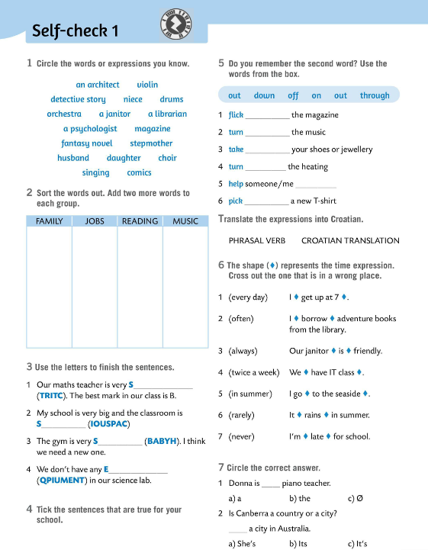
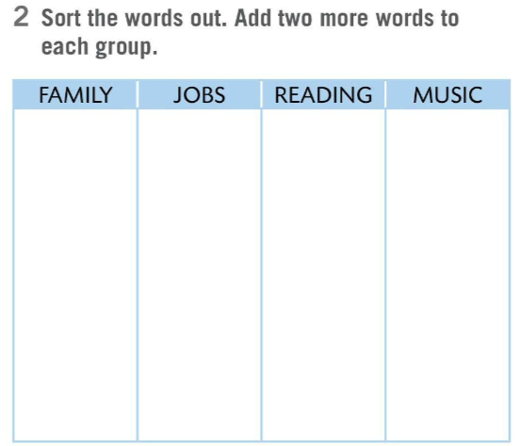
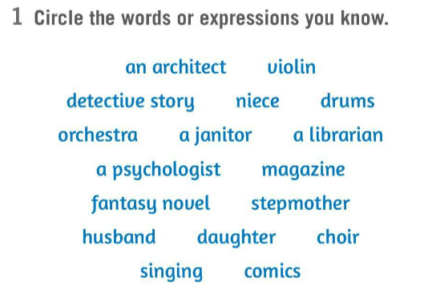
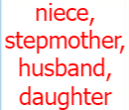
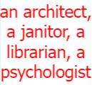


Do Task 1 and circle the words and expressions you know. Discuss in class which words are easier to remember and why.
Sort out the words from Task 1 into the table in Task 2.
Check.

Slide 4
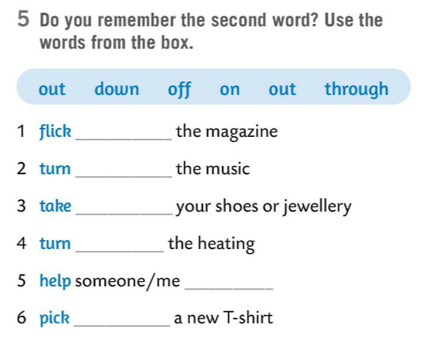
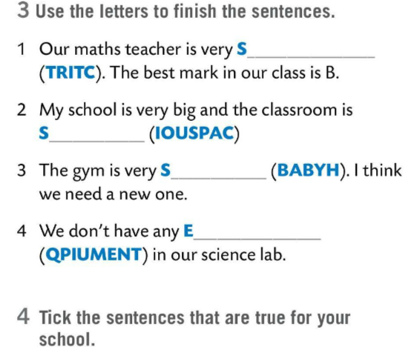
Use the letters in Task 3 to finish the sentences.
Check.
TRICT
PACIOUS
Put a tick next to the sentences that are true for your school. Discuss your answers in class.
through
HABBY
down
off
QUIPMENT
on
Use the words from the box in Task 5 and finish the expressions.
Check.
out
out

Slide 5
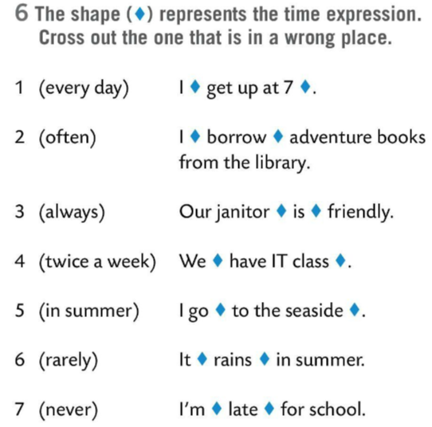
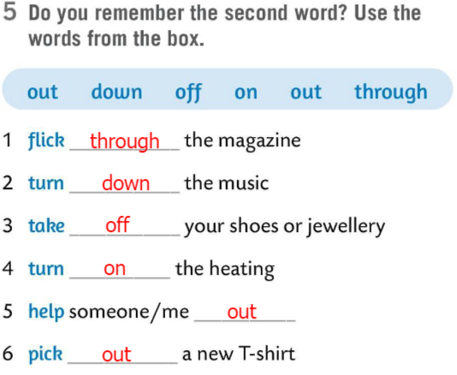
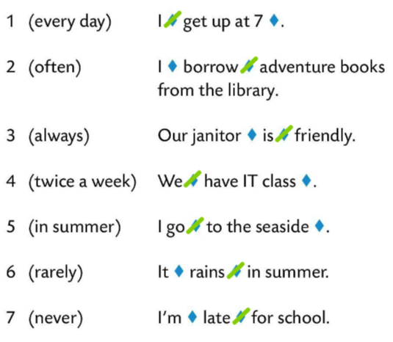
Translate the phrasal verbs from Task 5 into Croatian.
Check.
flick through – prelistati
turn down – smanjiti
take off – skinuti
turn on – upaliti
help someone/me out – pomoći kome
pick out – odabrati
Task 6. The shape represents the time expression. Cross out the one that is in a wrong place.
Check.

Slide 6
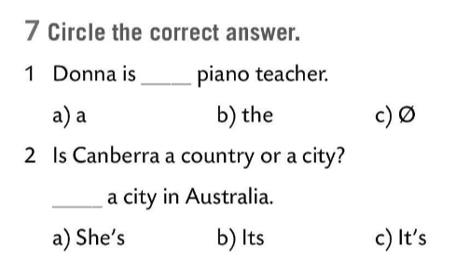

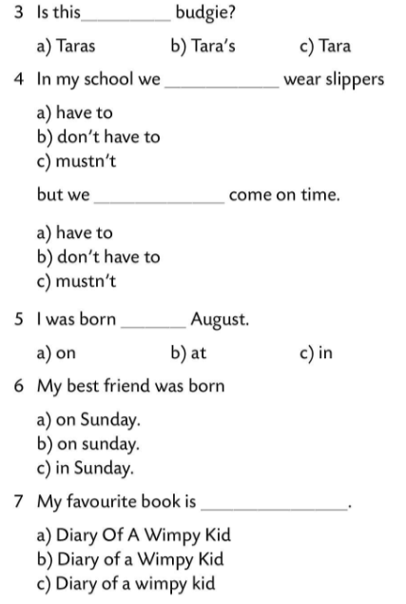
Circle the correct answer in Task 7.
Check.

Slide 7
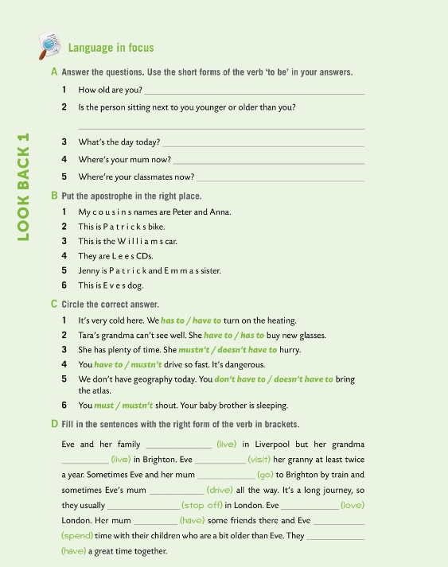

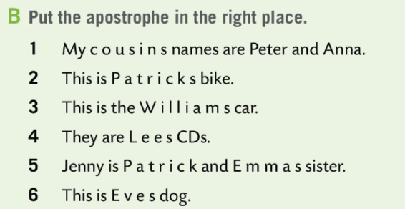
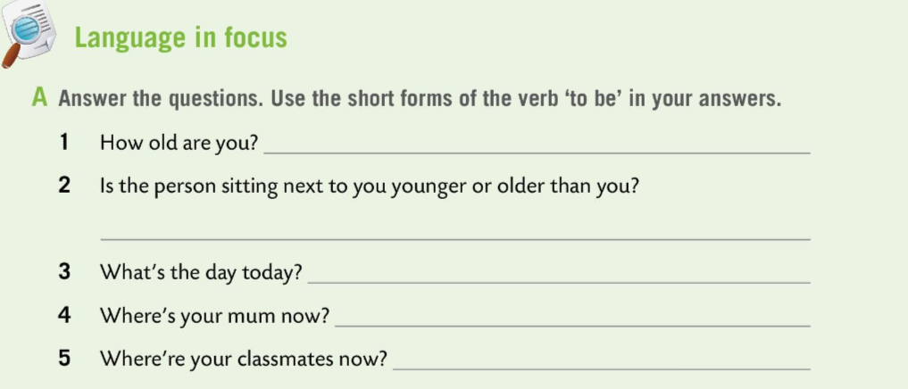
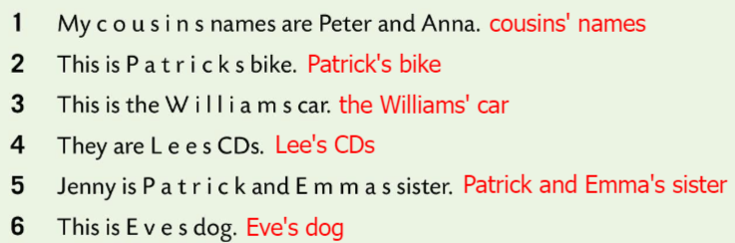
Workbook page 34. LOOK BACK 1
Answer the questions in Task A. Use the short forms of the verb ‘to be’ in your answer.
Check your aswers in class.
Put the apostrophe in the right place in Task B.
Check.

Slide 8
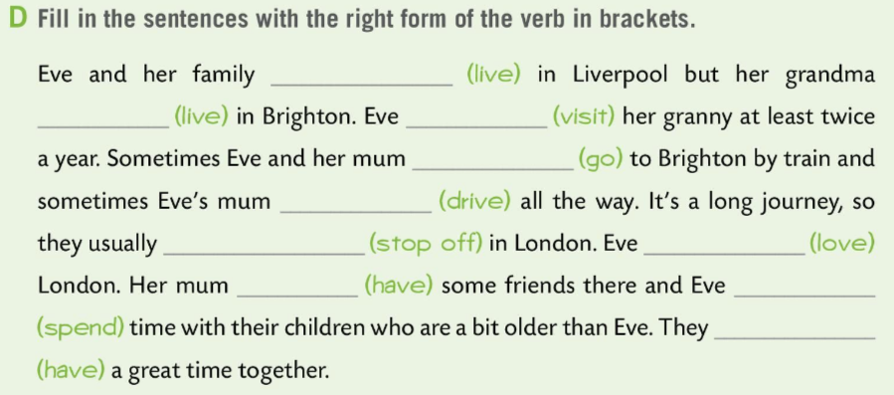
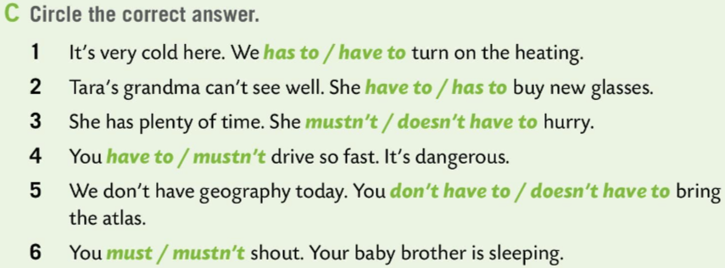
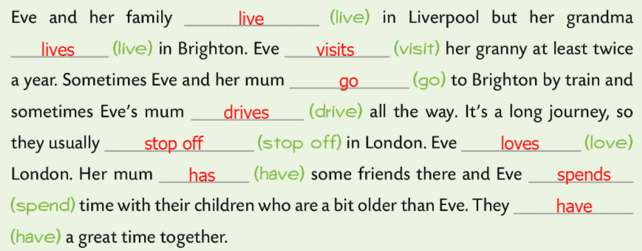
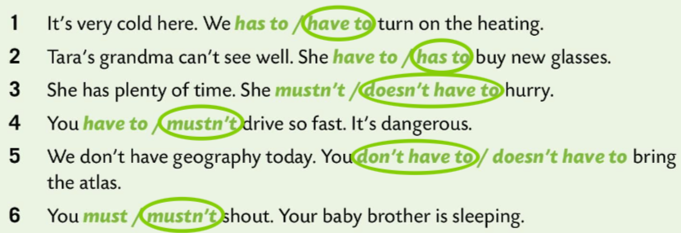
Workbook page 34. LOOK BACK 1
Circle the correct answer in Task C.
Check.
Fill in the sentences with the right form of the verb in the brackets in Task D.
Check.

Slide 9
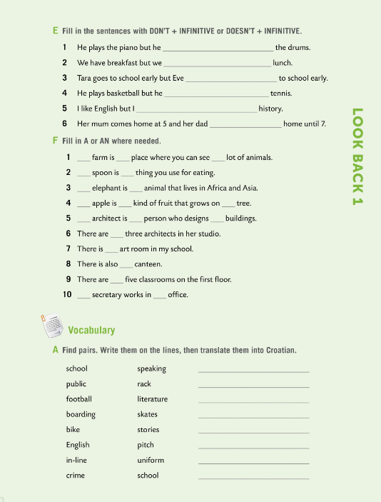
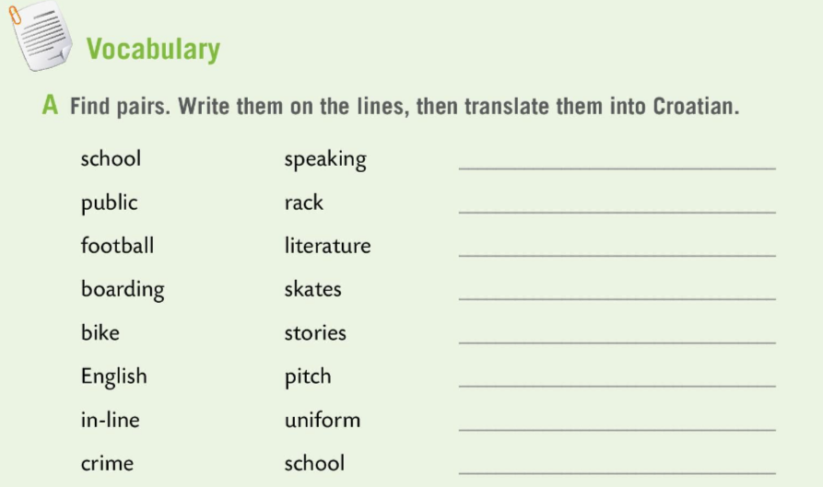
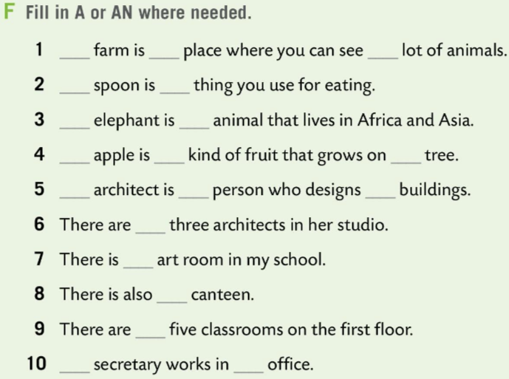
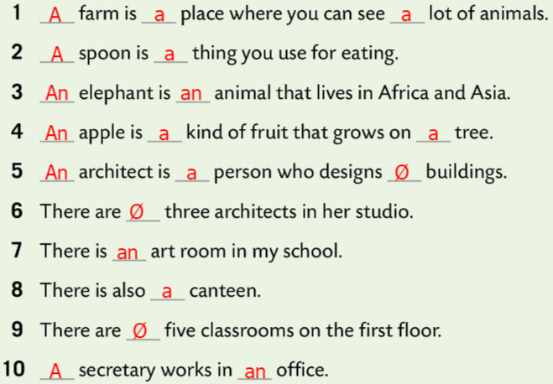
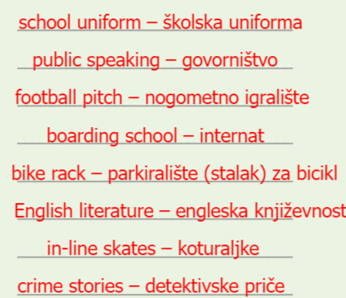
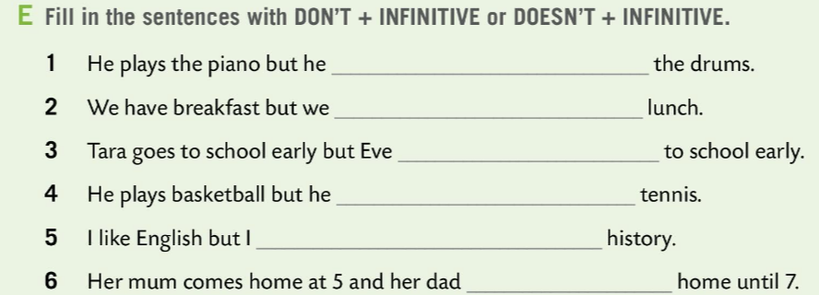
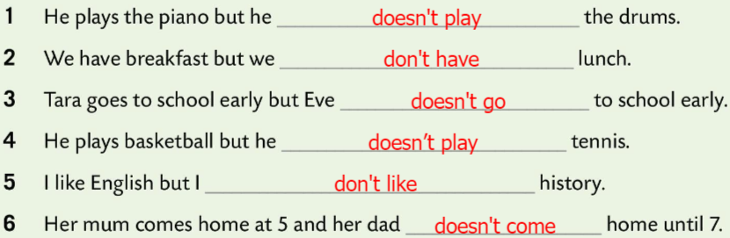
Workbook page 35. LOOK BACK 1
Fill in the sentences with DON’T + INFINITIVE or DOESN’T + INFINITIVE.
Check.
Fill in the sentences with articles A or AN where needed.
Check.
Find pairs. Write them on the lines, then translate them into Croatian.
Check.

Slide 10
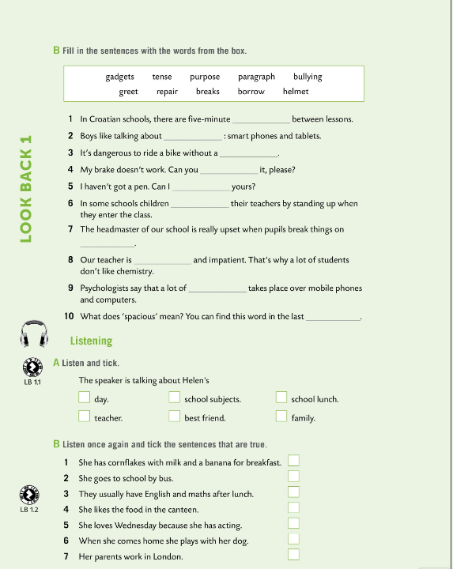
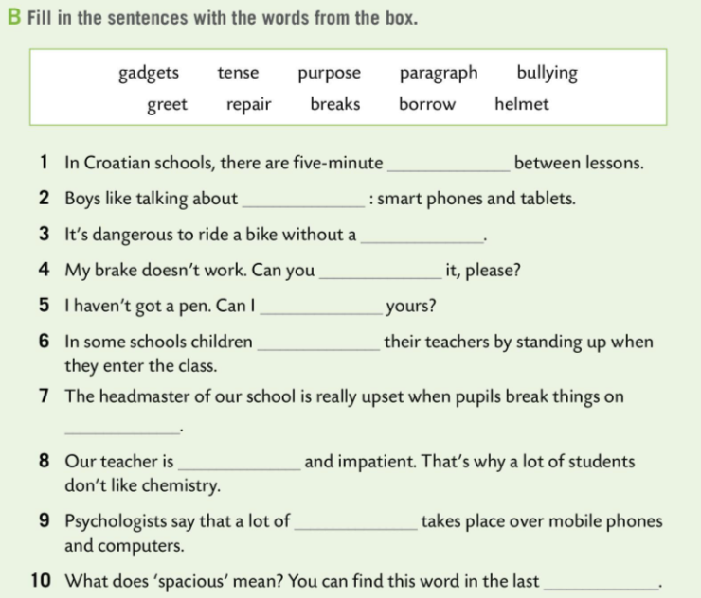
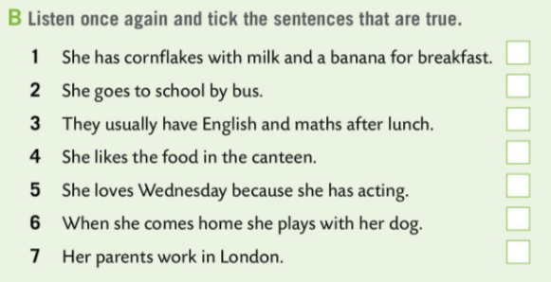
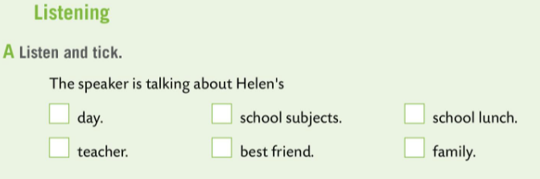
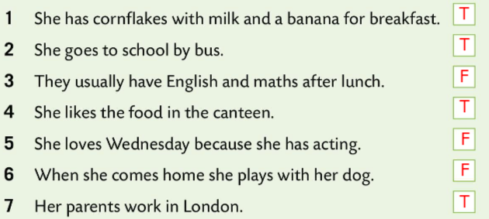
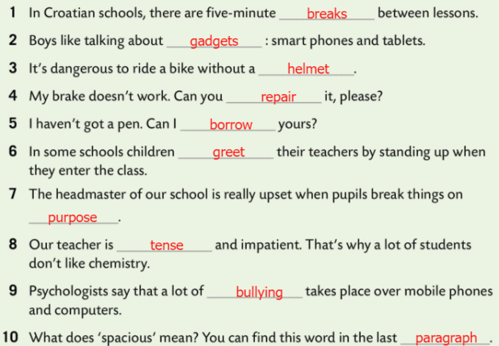
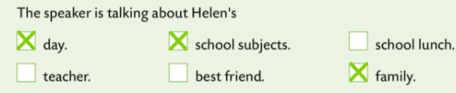

Workbook page 36. LOOK BACK 1
Fill in the sentences with the words from the box in Task B.
Check.
Time to practice listening. Listen and tick the correct box in Task A.
Check.
Listen once again and tick the sentences that are true. Write T or F.
Check.

Slide 11
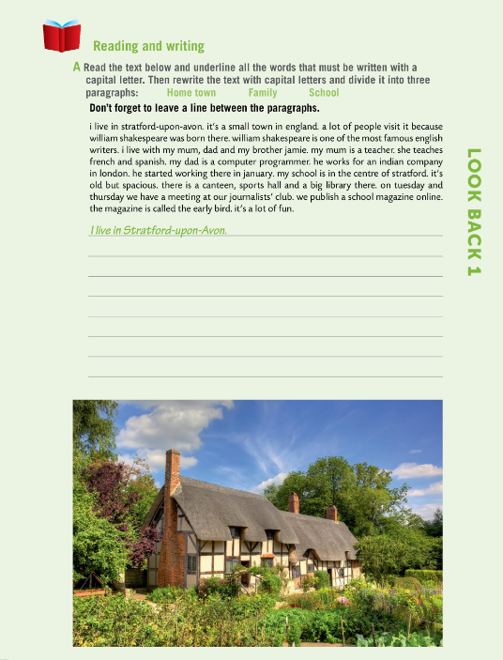
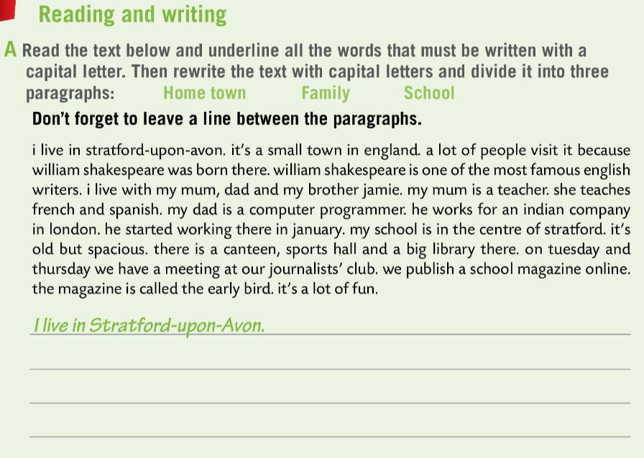
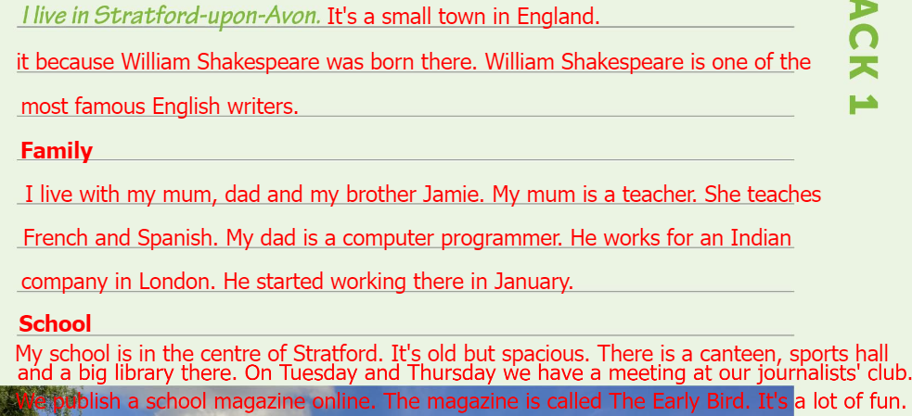
Workbook page 37. LOOK BACK 1
It’s time to work on your reading and writing skills.
Look at Task A. Read the text below and undeline all the words that must be written with a capital letter. Then rewrite the text with capital letters and divide it into three paragraphs: HOME TOWN, FAMILY, AND SCHOOL.
Check.

Slide 12
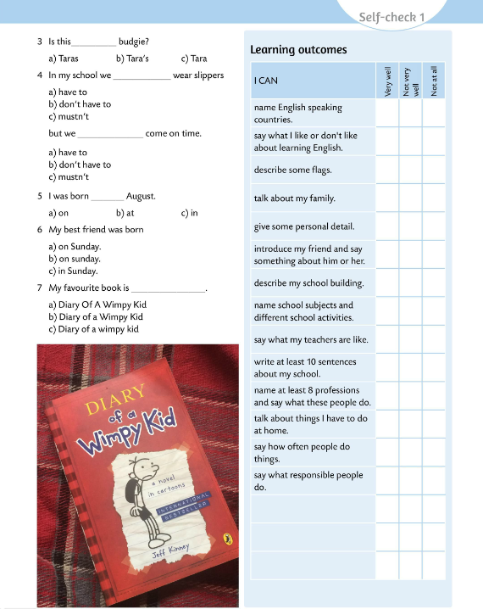
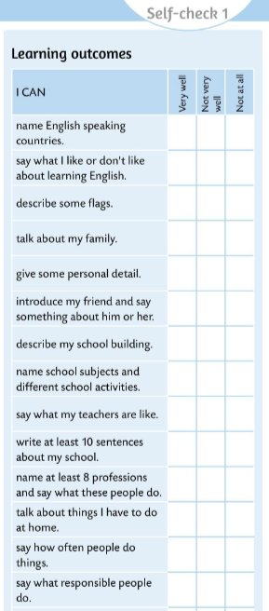

Look at the learning outcomes table.
Which of the outcomes did you master very well?
Which ones need more improvement?
Do you need more time and practice for any of them?
Be honest.

